Slide 1
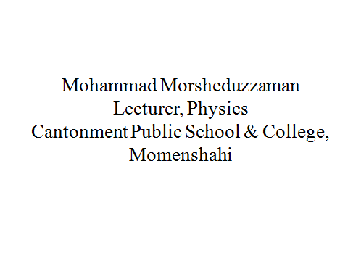
Welcome

Slide 2
Geometrical Optics
Creative Question
An object is placed at a distance of 24 cm from a thin bi convex lens, so that an image is found at a distance of 30 cm opposite side of the lens. The radii of curvature of the first and second surface of the lens are 16 cm and 20 cm respectively.
1. Find the refractive index of the material
2. If the lens is immersed in a liquid of refractive index 1.35, then find the focal length of the lens.

Slide 3
Geometrical Optics
Creative Question
1. Find the refractive index of the material
Given, u = 24 cm
v = 30 cm
r₁ = 16 cm
r₂ = -20 cm
= ?
We know,

Slide 4
Geometrical Optics
Creative Question

Slide 5
Geometrical Optics
Creative Question
2. If the lens is immersed in a liquid of refractive index 1.35, then find the focal length of the lens.
In case of air, Given, u = 24 cm
v = 30 cm
f _{a}= ?
We know,

Slide 6
Geometrical Optics
Creative Question
_{Again,}
In case of liquid,
From

Slide 7
Geometrical Optics
Creative Question

Slide 8
Geometrical Optics
Creative Question
An object is placed at a distance of 30 cm from a thin bi convex lens, so that an image is found at a distance of 40 cm at the same side of the object. The radii of curvature of the first and second surface of the lens are 16 cm and 20 cm respectively.
What is entropy?
1. Find the focal length of the lens.
2. If the lens is immersed in a liquid of refractive index 1.35, then find the image distance for the same object distance.

Slide 9
Geometrical Optics
Creative Question
1. Find the focal length of the lens.

Slide 10
Thermodynamics
Entropy
Entropy in reversible process:
By doing small changes in a system the process which can not be reversed through the previous path is called irreversible process.
Example: Creation of heat due to friction between two objects

Slide 11
Thermodynamics
Entropy
Heat death of the universe

Slide 12
Thermodynamics
Evaluation of phase-2
What is ‘heat death of the universe’?
Explain the change of entropy in an adiabatic process.

Slide 13
Thermodynamics
?

Slide 14
Thermodynamics
Home work
2. Write down 10 MCQ on today’s topics

Slide 15
Thanks

